Slide 1

Analyzing FEMA Public Assistance Dataset
Leveraging Azure Cloud & Power BI for Disaster Recovery Analytics
Team: Siddharth Bahekar | Kiran Kesarapu | Vikas Yellapu | Sriram Sai Bokka

Slide 2
Team contributions
Team Contributions
The project was executed collaboratively by the team, with equal distribution of work across data engineering, analytics, and documentation activities. Each team member contributed to specific components of the pipeline and played an active role in the successful completion of the project, including the report and presentation deliverables.
Siddharth Bahekar
Identified and selected the public FEMA dataset as the data source, ensuring relevance and usability for cloud ingestion and analytics.
Designed and developed Python notebook for pre-validation of data and performing cleaning.
Contributed extensively to the project report
Created the pipeline architecture diagram and designed key visual elements for the presentation.
Kiran Kesarapu
Configured and implemented Azure Data Factory for ingesting data from HTTP endpoints into Azure Data Lake Gen2 (Raw).
Ensured secure and efficient storage and retrieval of ingested raw data from the data factory pipelines.
Drafted and presented the Storage Management & Integration slides for the final presentation.
Contributed to the report sections related to storage setup and data governance.

Slide 3
Team contributions
Vikas Yellapu
Developed scalable data transformation workflows using Azure Databricks, handling data cleansing
Maintained Databricks notebooks for ETL processing, with integration into the cloud pipeline.
Documented the Data Processing & Transformation aspects of the project
Created corresponding slides and visualizations for Databricks processing in the presentation.
Sriram Sai Bokka
Configured Azure Synapse Analytics to query transformed data stored in Data Lake Gen2.
Built and published interactive Power BI dashboards for data visualization and reporting.
Drafted the Data Analytics & Visualization sections in the report
Presented insights and dashboard walkthroughs during the final project presentation.

Slide 4
What is the FEMA Public Assistance Dataset?
Provided by FEMA via OpenFEMA portal as a public dataset.
Contains detailed information on federally funded disaster recovery projects.
Covers disaster types like hurricanes, floods, wildfires, and earthquakes.
Key fields: funding amounts, applicant types, damage categories, location data, and project statuses.
Data is updated frequently and available via HTTP endpoints for automated ingestion.

Slide 5
Why This Dataset & Project Goals
Why FEMA Data?
Real-world relevance in disaster recovery and public transparency.
Open, accessible, and updated—ideal for cloud integration.
Suitable for learning scalable, production-grade pipelines.
Project Objectives
Build an automated cloud data pipeline.
Clean, transform, and enrich the data using modern tools.
Deliver interactive, actionable insights via Power BI.

Slide 6
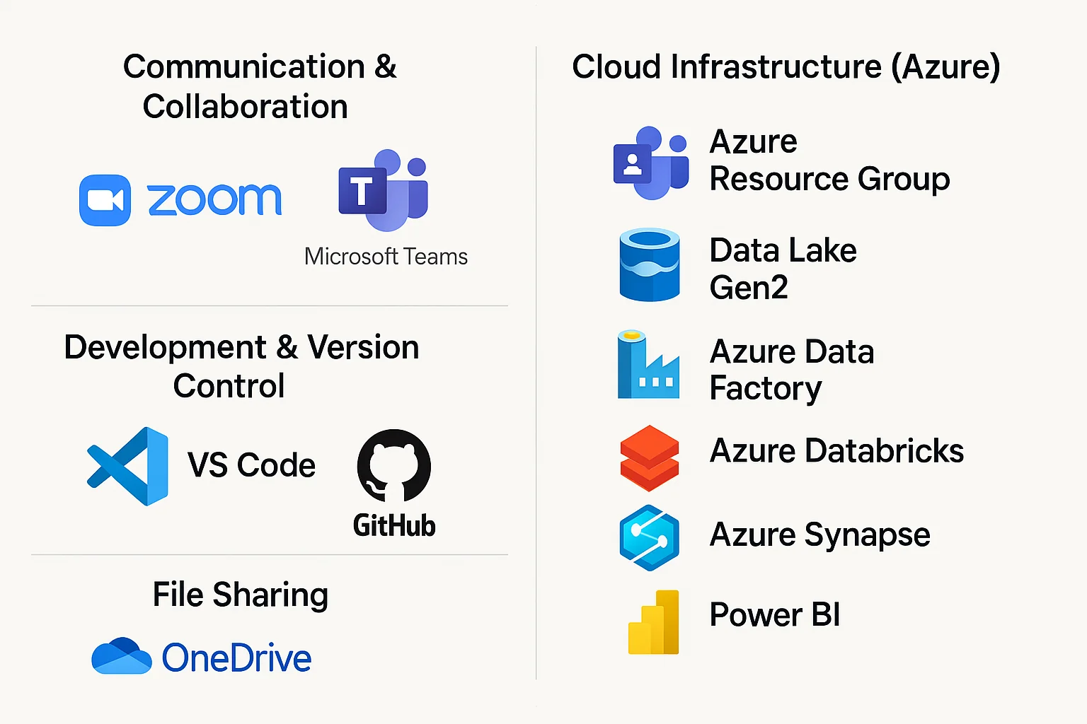
Tools & Technologies Used

Slide 7
Tools & Technologies Used
Azure Data Factory – Ingests raw data
Azure Data Lake Gen2 – Structured storage using bronze/silver/gold zones
Azure Databricks – PySpark notebooks for transformation, cleaning, and enrichment
Azure Synapse Analytics – External tables and SQL-based querying of transformed data
Power BI – Visualization layer connected directly to Synapse
GitHub – Hosts raw FEMA data accessed via ADF pipelines

Slide 8
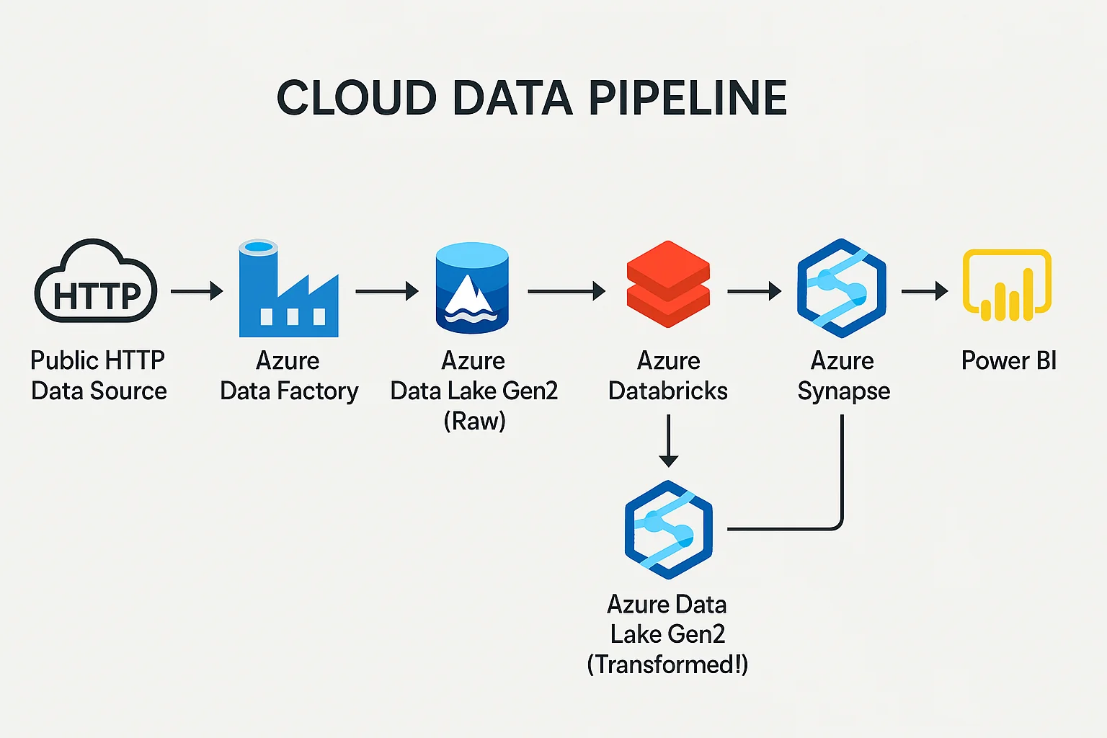
Architecture – End-to-End Pipeline

Slide 9
Architecture – End-to-End Pipeline
Data Source: Public HTTP endpoint from GitHub
Ingestion: Azure Data Factory pipelines with Lookup + ForEach + Copy activities.
Raw Zone: Data Lake Gen2 – Bronze container.
Transformation: Azure Databricks performs data cleaning and fills nulls.
Transformed Zone: Parquet data written to Silver layer in Data Lake.
Serving Layer: Azure Synapse creates external tables on top of Silver/Gold data.
Visualization: Power BI dashboards query Synapse directly.

Slide 10
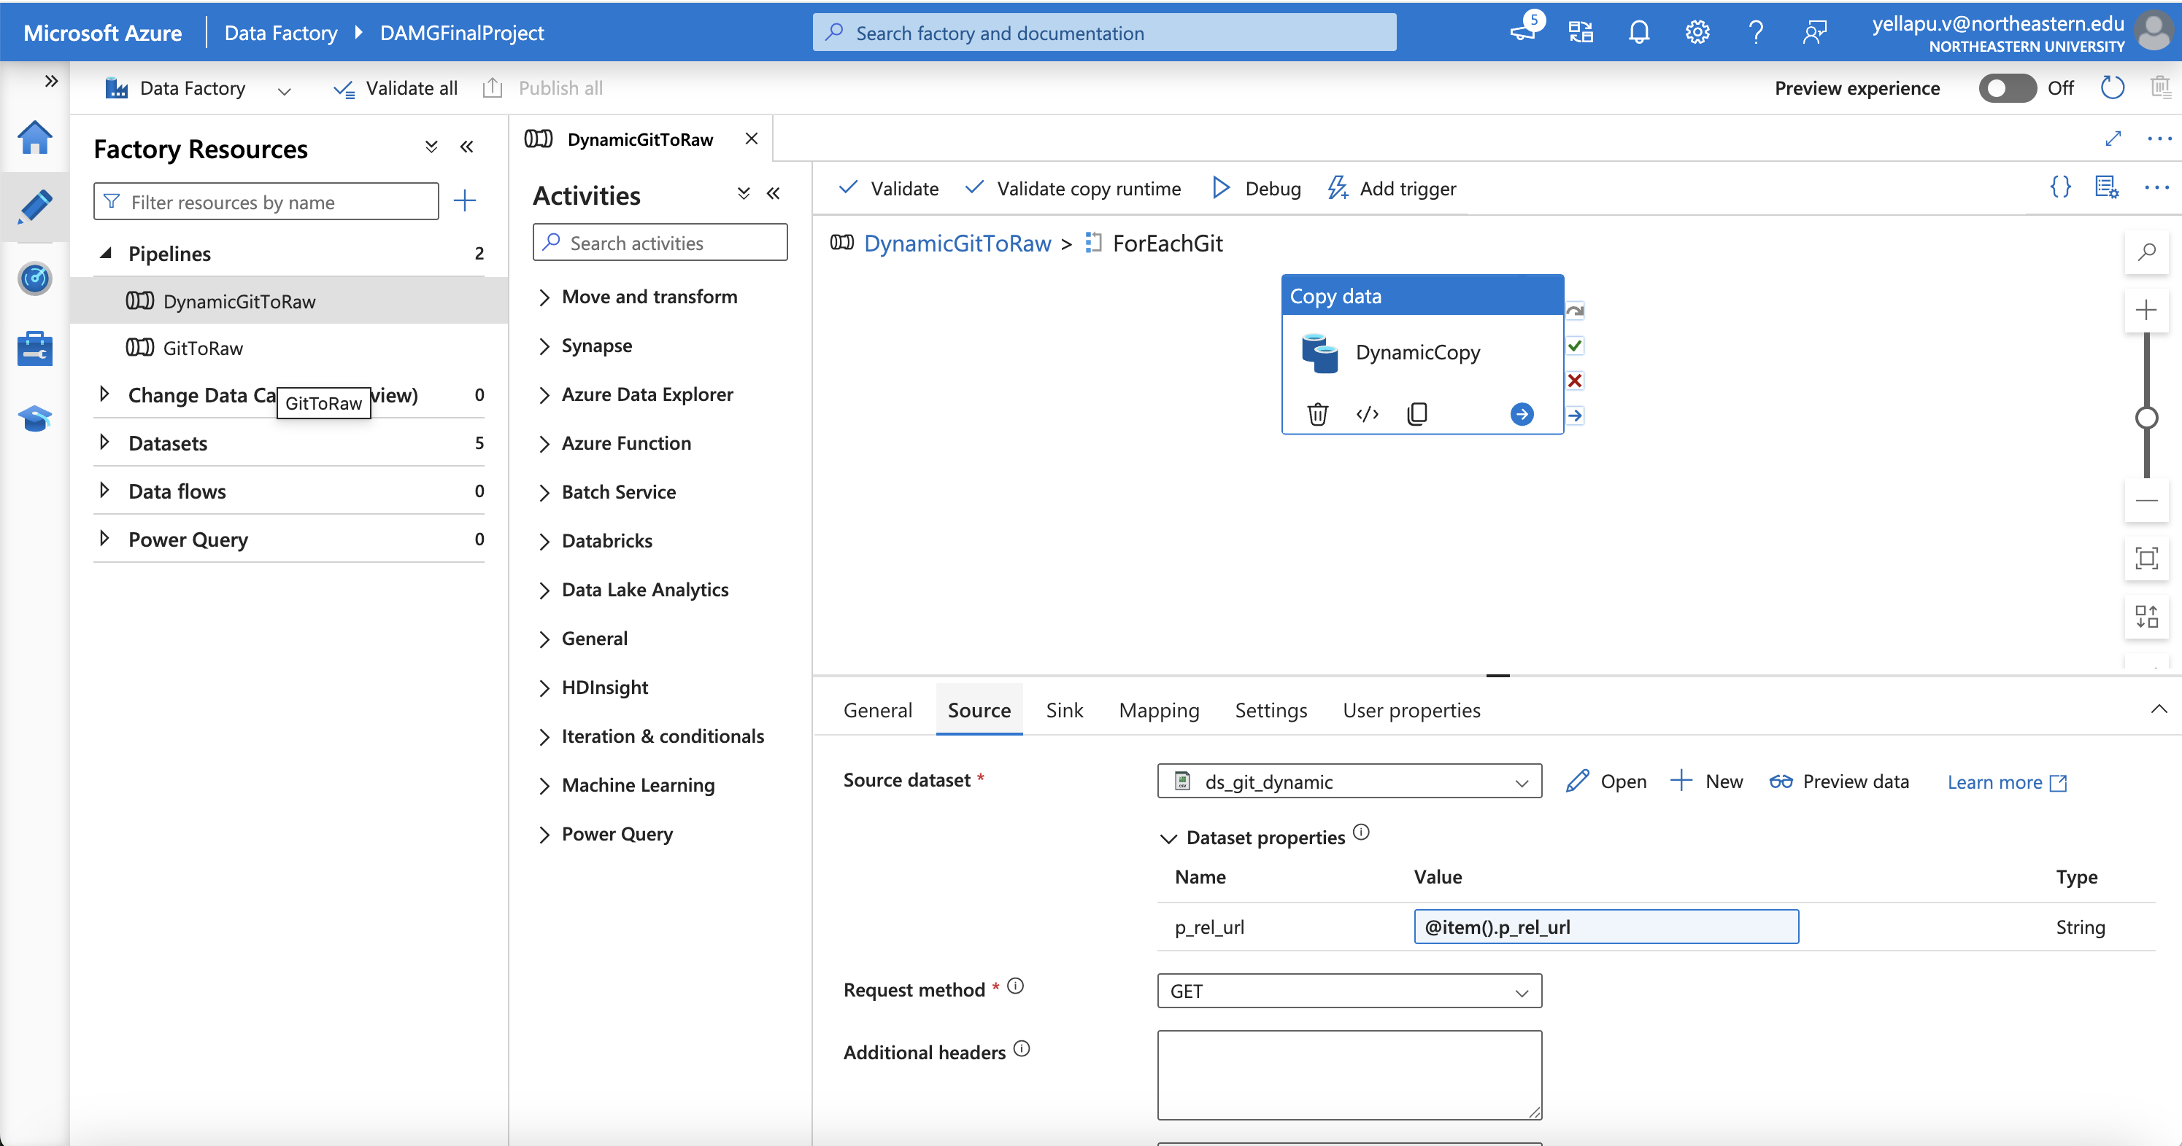
Azure Data Factory & Data Lake Gen2
ADF dynamically ingests multiple URLs using Lookup and ForEach control flow.
Copy Data activity uses parameterized dataset with HTTP-linked service.
Data is securely stored in the bronze container using Data Lake Gen2.
Bronze/Silver/Gold layering supports versioning, modularity, and traceability.

Slide 11
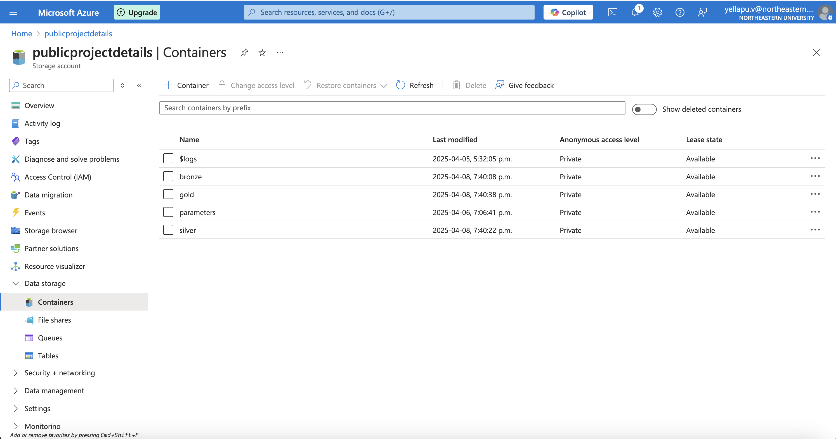
Azure Data Factory & Data Lake Gen2

Slide 12
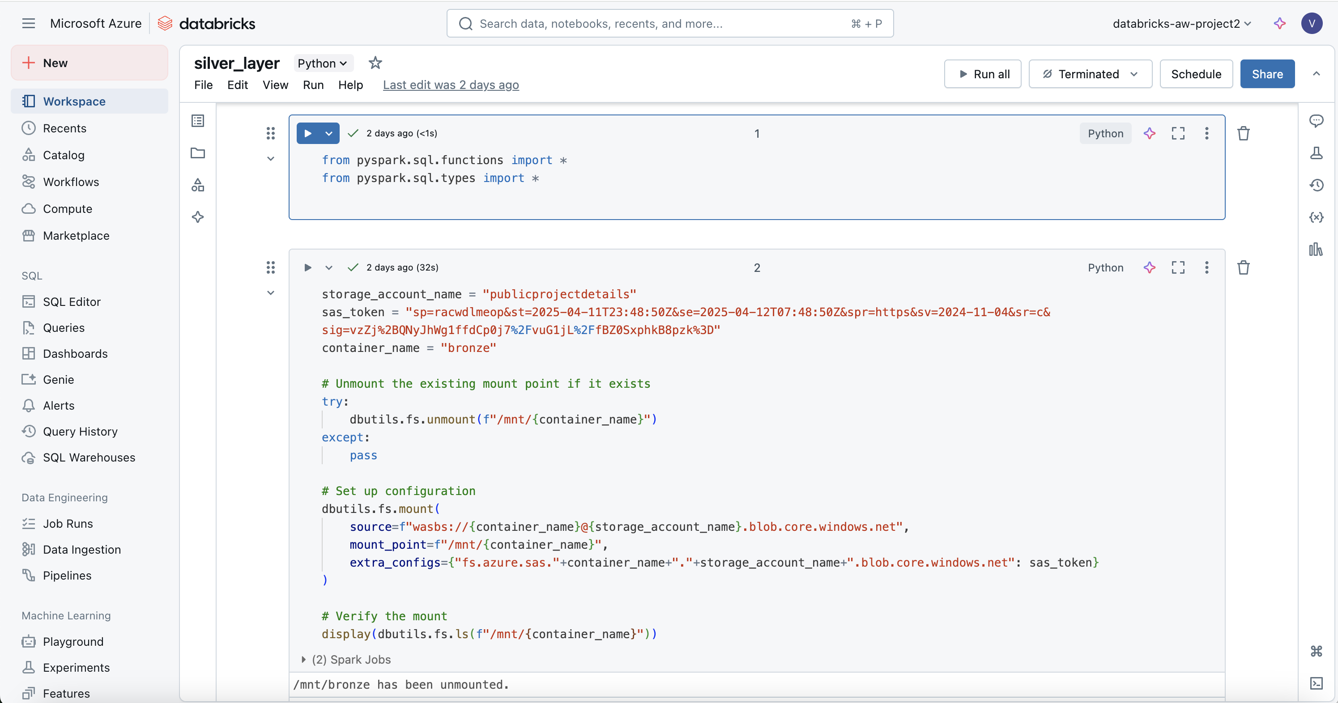
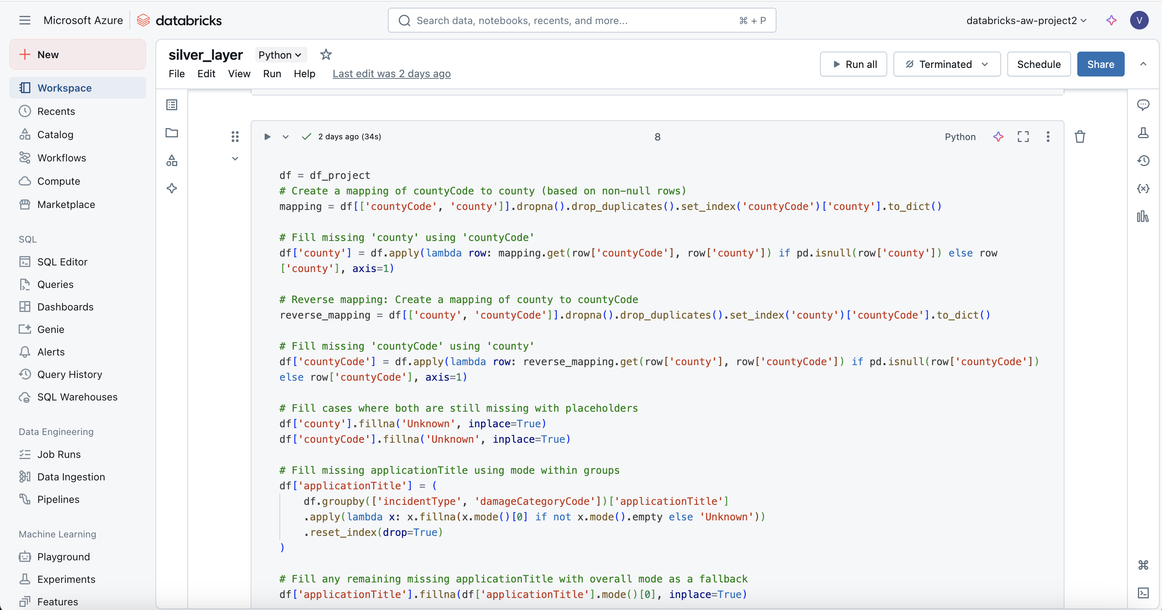
Data Cleaning & Transformation – Azure Databricks

Slide 13
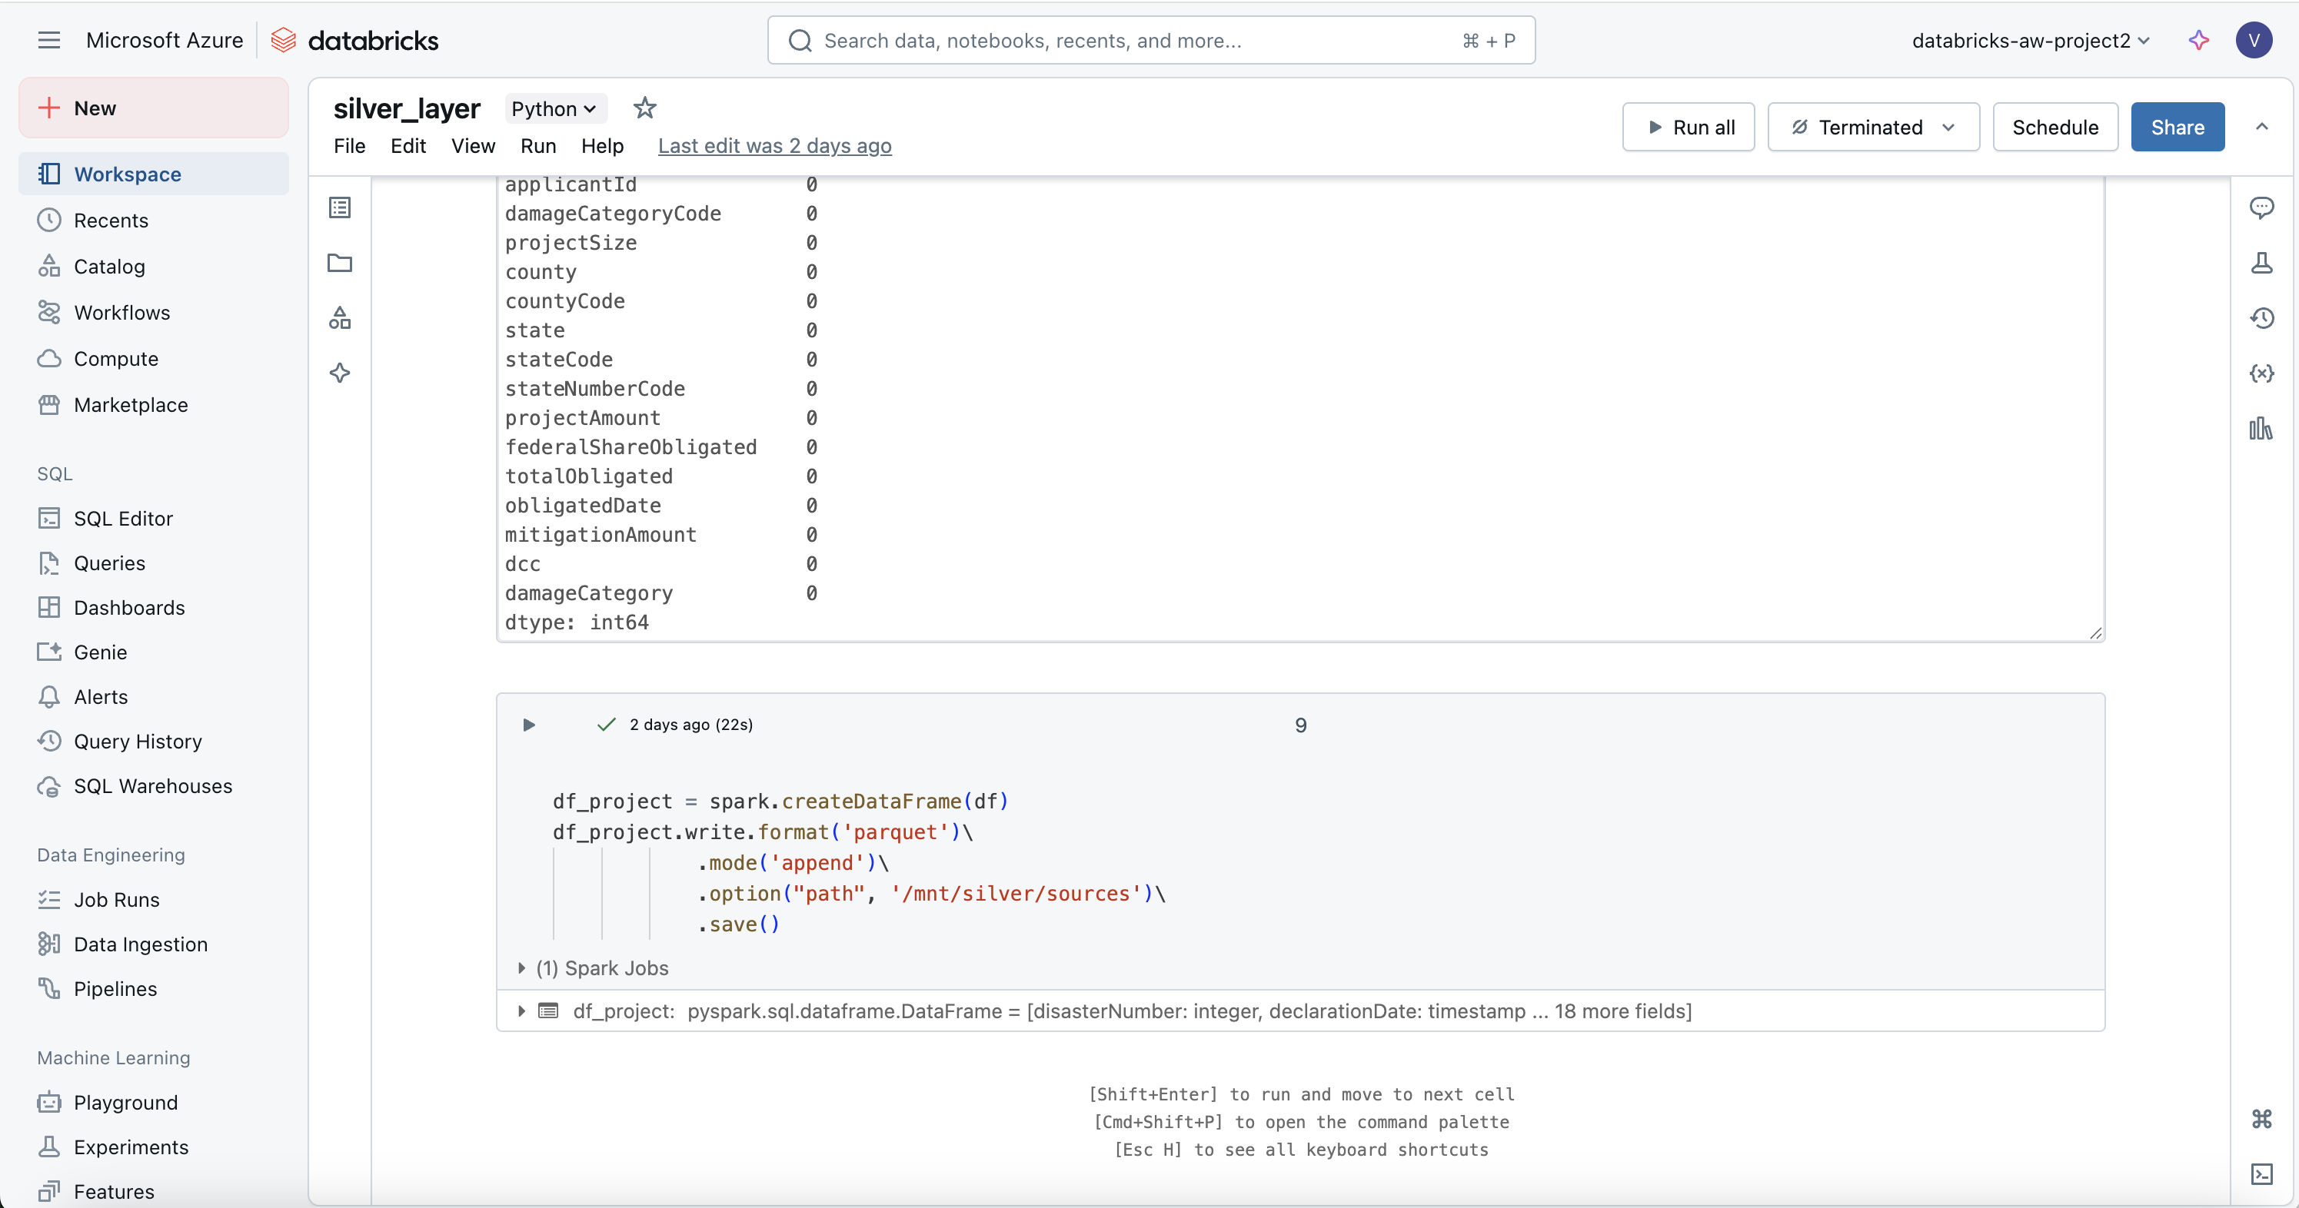
Data Cleaning & Transformation – Azure Databricks
Raw CSV data loaded into PySpark DataFrames.
Null handling via reverse mapping: countyCode ↔ county.
Mode imputation used to fill missing applicationTitle by damage category.
Transformed data saved as optimized Parquet in the silver container.
Ensures schema consistency and query performance in downstream tools.

Slide 14
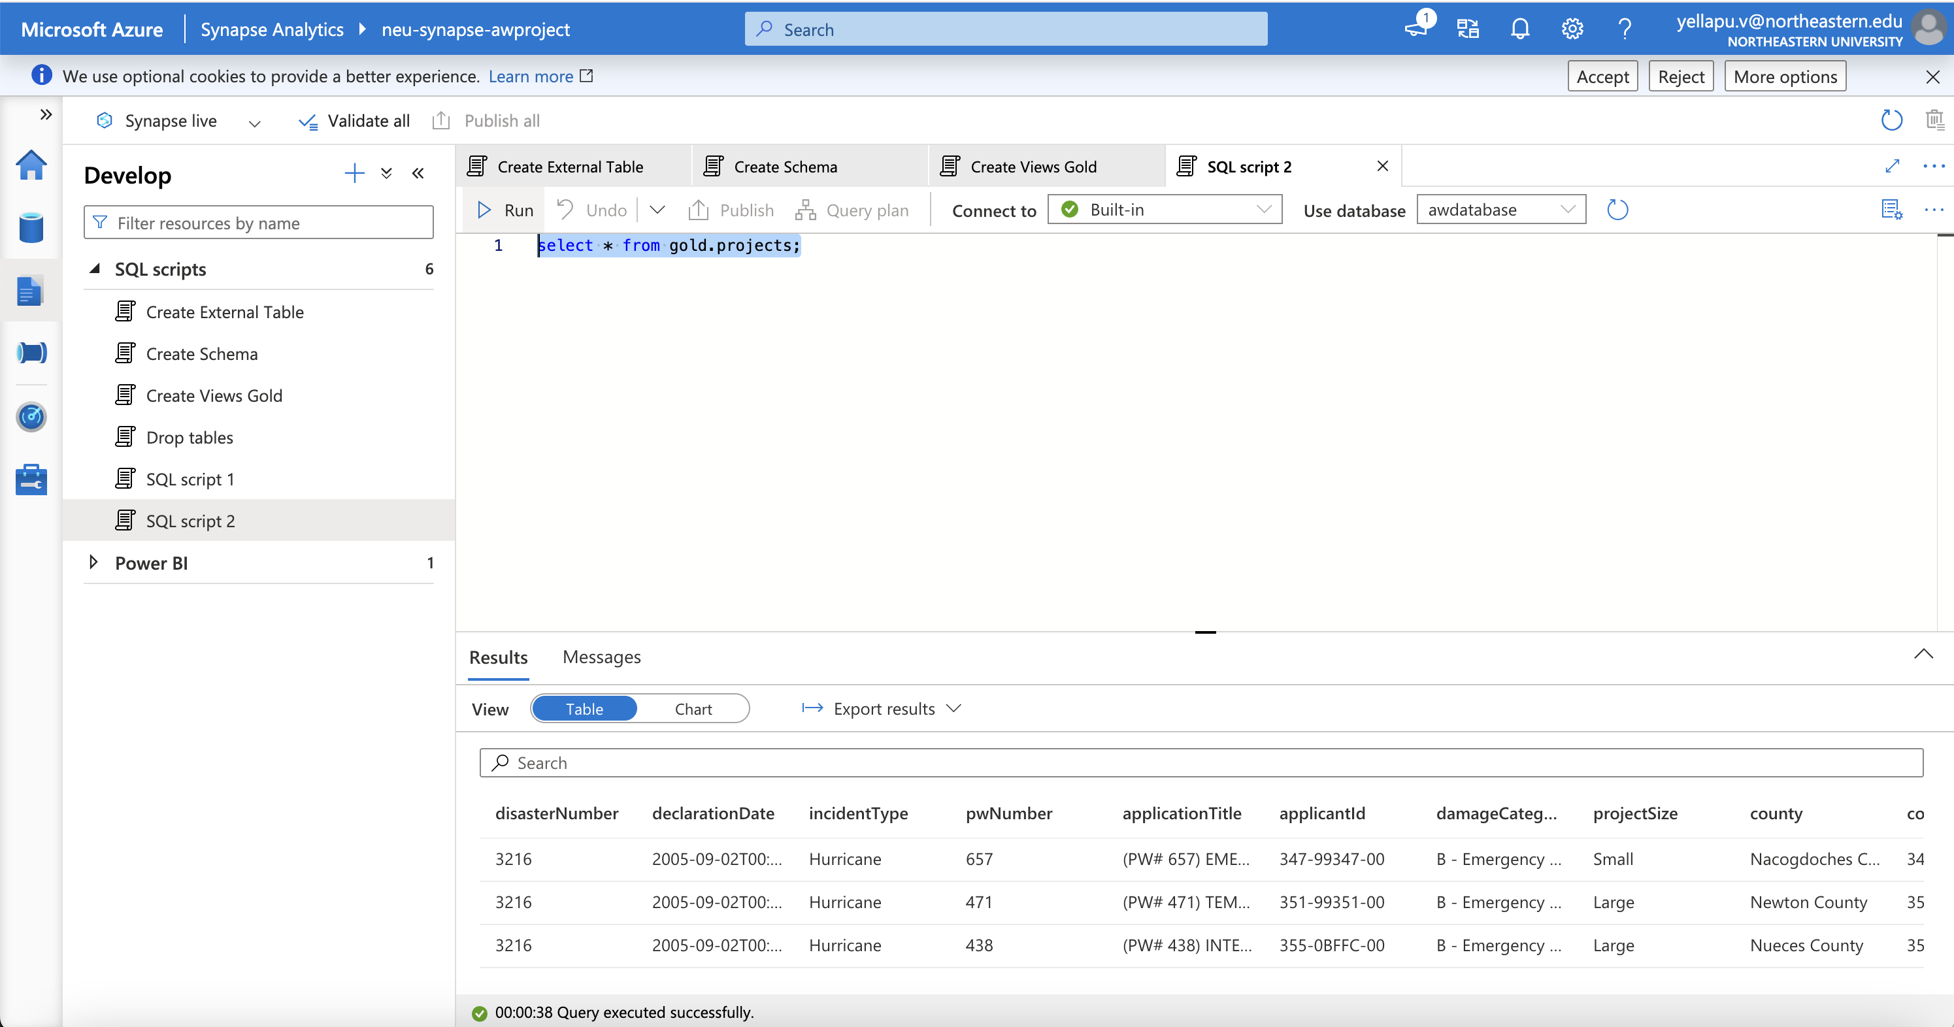
Analytics & Query Layer – Azure Synapse
Synapse external tables created using Parquet file format.
Utilizes Managed Identity for secure data access.

Slide 15
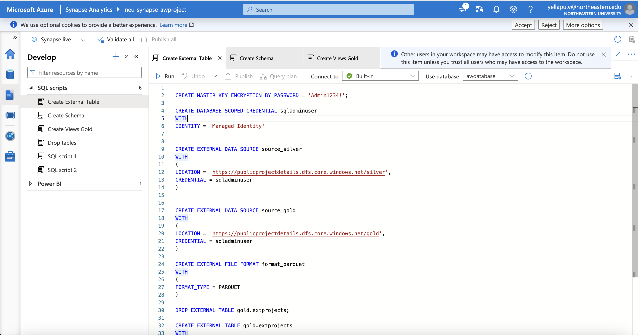
Analytics & Query Layer – Azure Synapse
SQL queries run directly on silver/gold data—no duplication or movement.
Synapse enables efficient joins, aggregations, and filtering for large-scale data.

Slide 16
Power BI Dashboards – Key Visuals
Live connection to Synapse provides real-time insight delivery.
Visualizations created:
Funding by Damage Category (e.g., Roads, Public Buildings)
Total Obligated Funds by State and Year
Incident Types (Hurricanes, Fires, Floods)
Application Titles (COVID-19 Staffing, Debris Removal)
Dashboards designed for stakeholders and policy analysts.

Slide 17
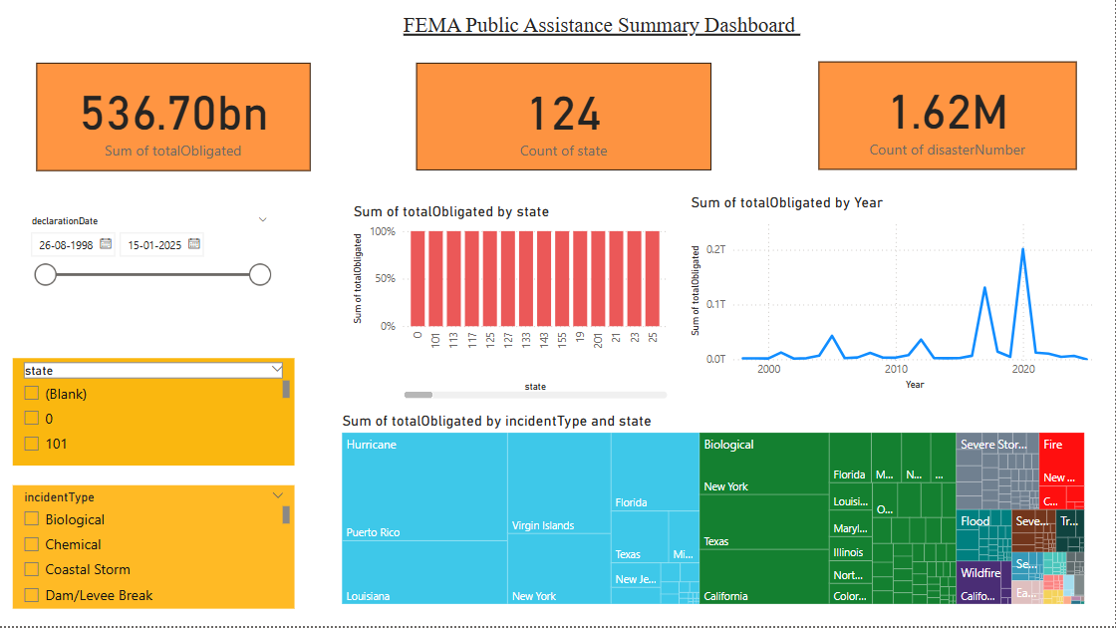
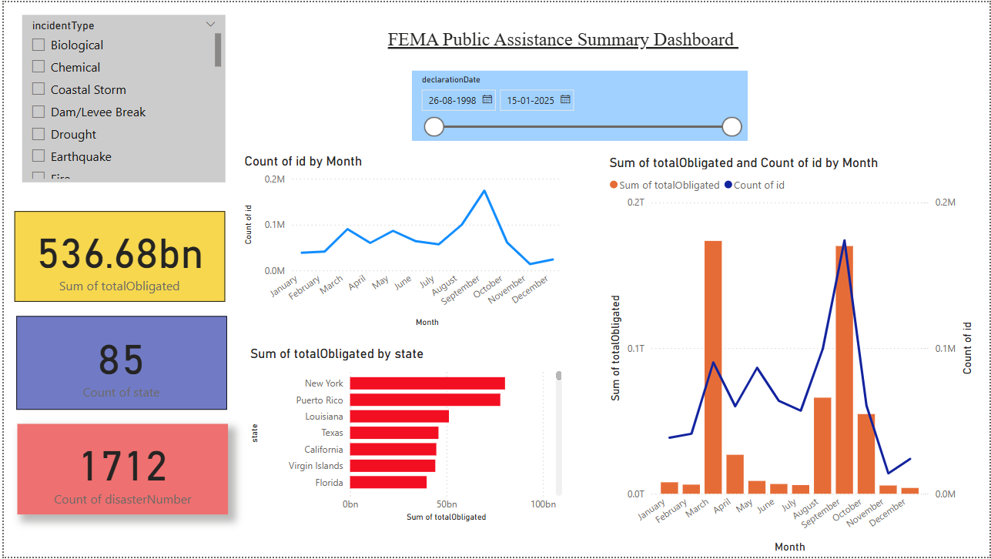
Power BI Dashboards – Key Visuals

Slide 18
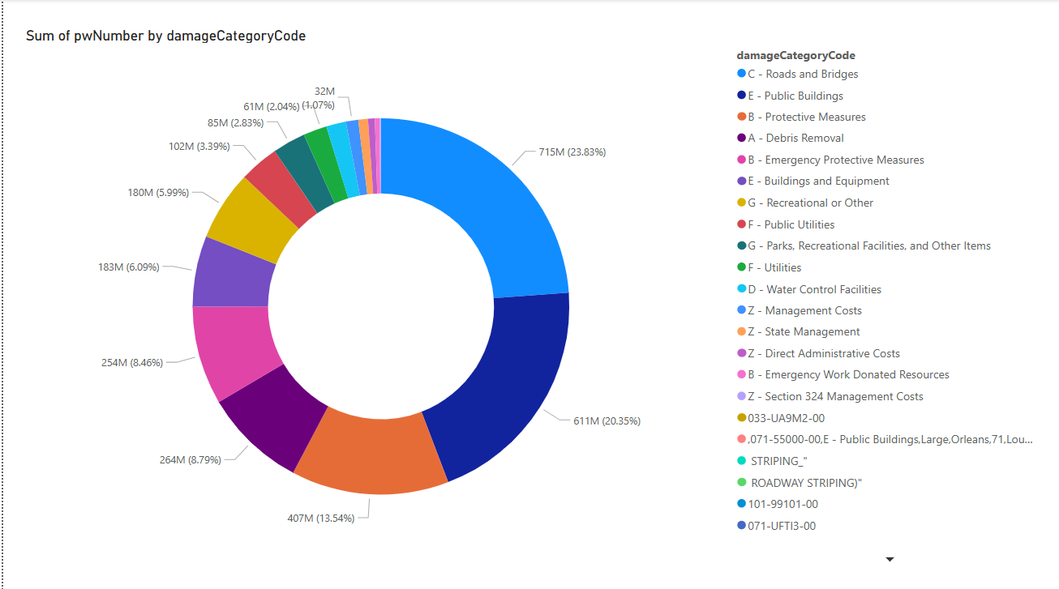
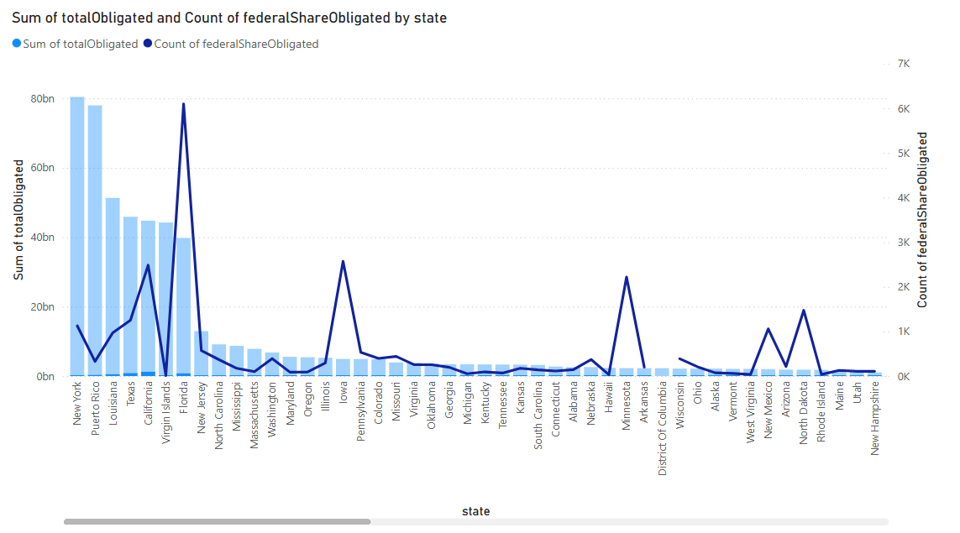
Power BI Dashboards – Key Visuals

Slide 19
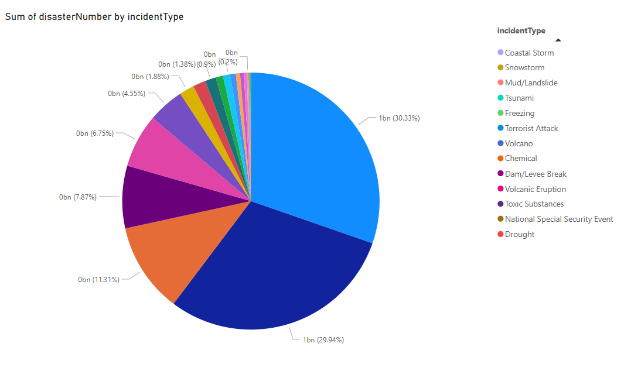
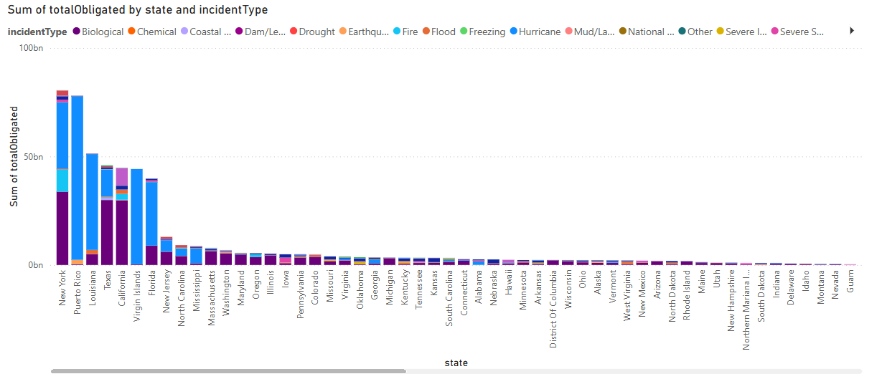
Power BI Dashboards – Key Visuals

Slide 20
Challenges, Learnings, and Future Scope
Challenges Faced
Handling large-scale datasets across distributed systems.
Ensuring schema integrity across raw and transformed zones.
Efficient joins in PySpark and optimization of Power BI visuals.
Learnings
Hands-on with Azure-native services.
Best practices in medallion architecture and modular pipeline design.
Real-world visualization aligned with policy and community impact.

Slide 21
Challenges, Learnings, and Future Scope
What next?
Automate pipeline triggers and monitoring
Add more real-time data feeds
Expand Power BI with drilldowns and user filters
GitHub link - https://github.com/yvikasofficial/data_arch_final_project

Slide 22
Thank you

